Slide 1
AI Creativity with Text Generation
Zhiling Zhang
2022.3

Slide 2
Contents
Introduction
Creative Machine Generation
Model
Decoding Method
Human-AI Co-Creation
Conclusion

Slide 3
Contents
Introduction
Creative Machine Generation
Model
Decoding Method
Human-AI Co-Creation
Conclusion

Slide 4

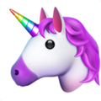
In a shocking finding, scientist discovered a herd of unicorns living in a remote, previously unexplored valley, in the Andes Mountains. Even more surprising to the researchers was the fact that the unicorns spoke perfect English.
The scientist named the population, after their distinctive horn, Ovid’s Unicorn. These four-horned, silver-white unicorns were previously unknown to science.
Now, after almost two centuries, the mystery of what sparked this odd phenomenon is finally solved.
Dr. Jorge Pérez, an evolutionary biologist from the University of La Paz, and several companions, were exploring the Andes Mountains when they found a small valley, with no other animals or humans.
Mystery of Unicorn -- Author: GPT-2
Notes:
First, let’s read a story.
This interesting story, is mostly written by AI, GPT-2

Slide 5
More Examples of AI Creativity
Poem
北风吹雪泪沾裳，
胡马南来路已荒。
万里烽烟连朔漠，
三边鼓角起悲凉。
Author: 九歌 (THUNLP)
Special Poem
单身狗
清水饼干难下咽，
华歌月酒不能尝。
大龄蛋白宅男女，
学界萧条剩贱郎。
Author: 悟道 (BAAI)
Notes:
Modern AI is also capable of creating more kinds of interesting works.

Slide 6
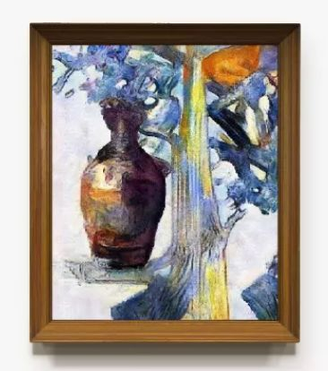
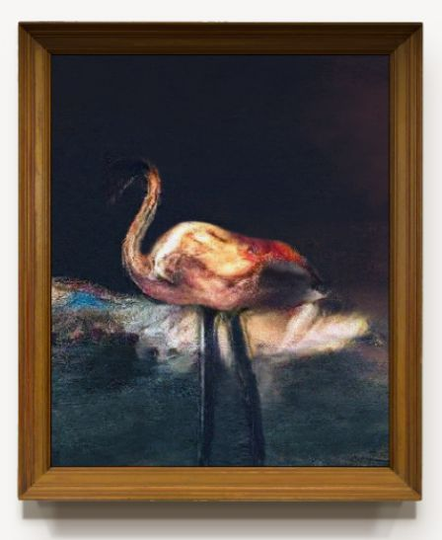
More Examples of AI Creativity
Author: XiaoIce
Notes:
They can also produce great visual arts, just like these 2 images, which are created by XiaoIce.
In this talk, I will mainly focus on textual creativity, but I will also adopt many examples of visual creations for my following illustration as they might be more intuitive.
OK, I’ve just used the word “art”. But, can we consider the creation of AI as true “art”? Some people has just given us their answer.

Slide 7
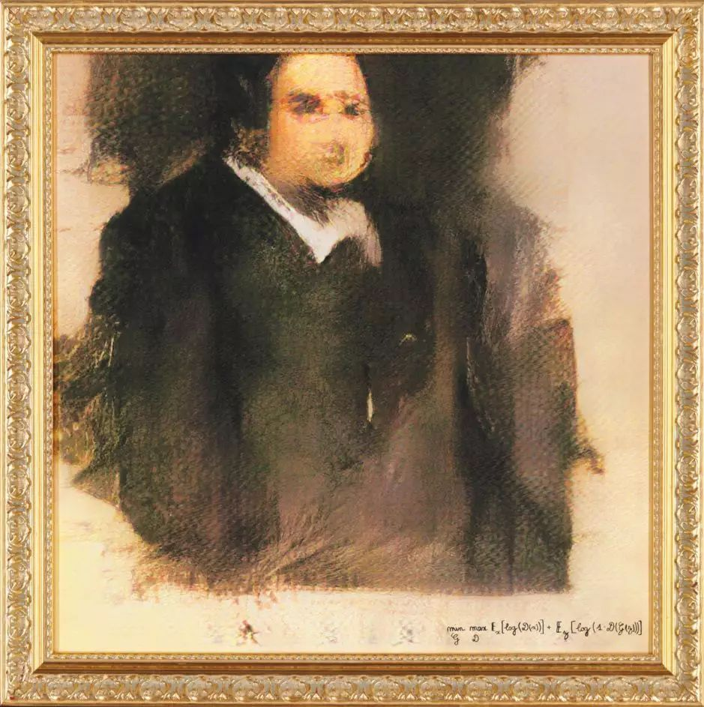
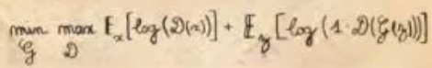
AI “Art”
Portrait Of Edmond de Belamy
Sold for $432,500 in a 2018 Christie's auction
GAN-created Artwork
Signed at the bottom with the algorithm that created it
Notes:
This is the first well recognized AI “art” work. As you can see, it is created by a GAN, and has sold a very high price in an auction. Therefore, we know that these people do appreciate the art value of this image. I don’t know how you would feel about it?
Anyway, this work does have a very interesting point in my opinion. Let’s see a detail.
It is signed with something that many of you should be familiar with.

Slide 8

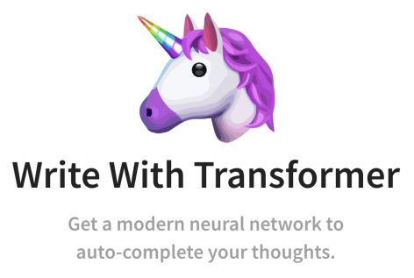
Human Art VS AI Art ?
VS
Notes:
So, if the creation of AI can be considered as Art, this will raise a natural question?
Is AI Art better than human Art?
Will human artists be replaced by AI Art?

Slide 9
Discussion
Do you think AI can have creativity?
Do you think the creations of AI can be considered as art?
How do we usually consider the value of an artwork?
Before Creation
Artist
Background
…
Creation Itself
Content
Material
…
After Creation
Presentation
Audience
…
Notes:
So, Let’s discuss some problems here.
First, Do you think AI can have creativity? It might be a very controversial problem in the past. But after seeing so much examples, I would now confidently say yes.
Next question is: (anime) Do you think the creations of AI can be considered as art?
This one can be more controversial, since we have certain standard of art values, and we haven’t got a clear framework to evaluate the art value of an AI creation.
Therefore, I’d like to tackle another question first: (anime)
How do we usually consider the value of an artwork? (pause)
Here I just give my way to think about it. (anime)
We can divided the sources of art value along time.
That is, different factors of art value are distributed before creation, after creation and in creation itself.
First, it is certain that we mainly judge an art work by its content.
Moreover, I think we will also acknowledge that who is the author, and its background affects our judgement.
Last but not least, the value of an artwork is not decided when it has been complete, but also will still be influenced by factors after creation.
I will give more examples on this.

Slide 10
Art Value: Before Creation
我家门前有两棵树，一棵是枣树，另一棵也是枣树。
——我自己说的
我家门前有两棵树，一棵是枣树，另一棵也是枣树。
——鲁迅
背景： 此文写于1924年9月的北京。当时，在帝国主义和北洋军阀相互勾结实行统治的情况下，中国北方的民主革命处于低潮。同时，“五四”退潮后新文化战线发生了分裂，思想界起了巨大分化。此时，作者鲁迅不免孤寂、彷徨，但他没有丧失勇气和信心，一方面急切地找寻生力军，一方面孤军奋战，坚忍地进行反帝反封建的斗争。
这句话强调了两株枣树傲然独立、凛然不可侵犯的精神风貌，又形成了全文整体意境中的骨脊，特别鲜明突出。
Notes:
These 2 sentences are the same right.
But if I show you the different authors, will you still feel the same?
Now I will further show you its background.
I think now you may have a further different view on this sentence, since it may not be as causal or funny as we used to think, but may be very serious.
That it how factors before creation impact our evaluation of an art work.

Slide 11
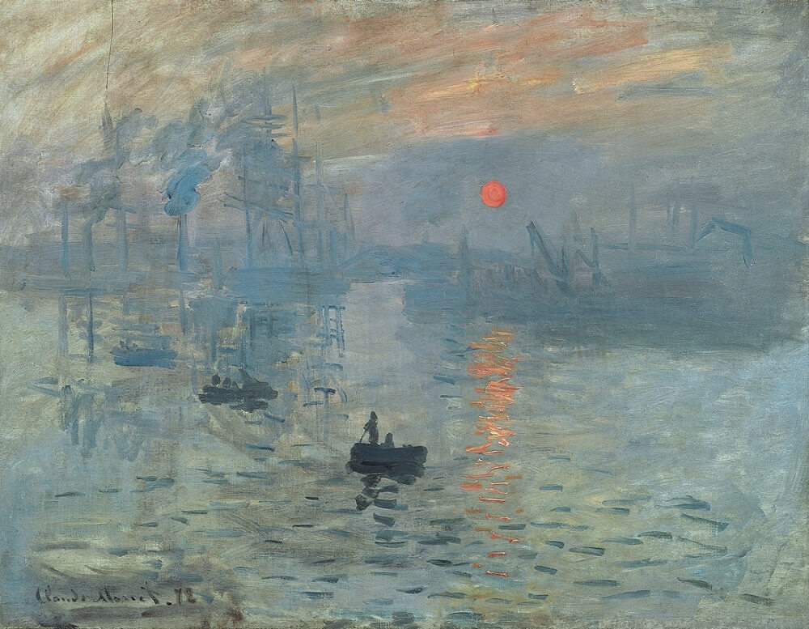
Art Value: After Creation
“Monet depicts a mist, which provides a hazy background to the piece set in the French harbor. The orange and yellow hues contrast brilliantly with the dark vessels, where little, if any detail is immediately visible to the audience. ”
“Absolutely unable to recognize what was shown at all.”
—— visitors of its first exhibition
Impression Sunrise by Claude Monet
Notes:
I think most of us should be familiar with this one.
And I’ve shown a typical comment on this image now, which may help us better appreciate the charm of this image.
However, different audience may have different opinions. (anime)
For example, when it is first exhibited, it received the comment “xxx”. I think it may still make sense to some audience now.
So by this example, I’d like to show that the audience’s preference, or other people’s comment, these after creation factors can also impact our judgements on the same artwork.

Slide 12
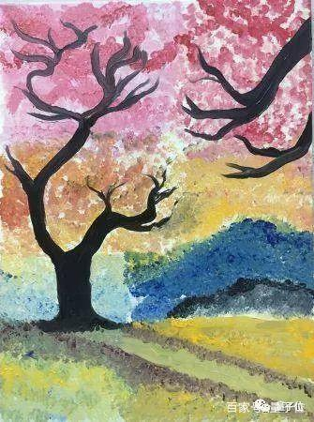
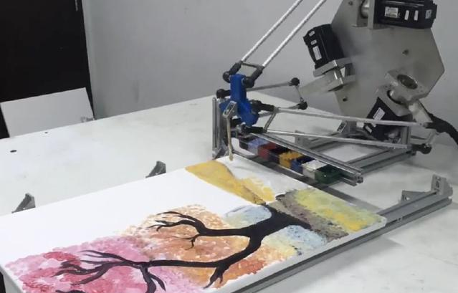
AI Art Value: Content Itself
AI can create almost the same “thing”/substance as human
→ Comparable Art Value
Notes:
OK, now that we’ve discussed how we evaluate classical human artworks, now let’s turn to AI Art Value.
This is another example of AI painting. I think it is already not distinguishable with a human painting.
But some people may claim that it is digital, rather than some real things like oil paintings.
But actually, it is. (anime)
As we can see, this robot is capable of real painting. (anime)
Therefore, we can claim that xxx
你能看出来这是机器人的绘画？ (baidu.com)

Slide 13
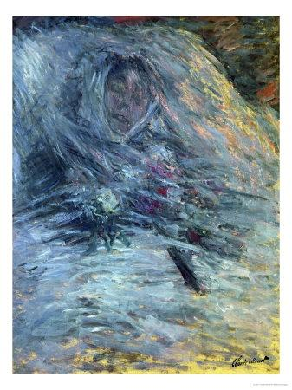
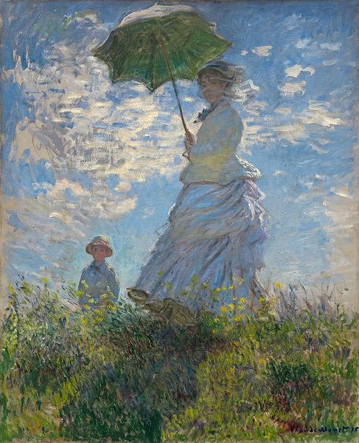
AI Art Value: Before & After Creation
Background
Comment
“那天，我发现自己珍爱的女人死了。我很惊诧。她的眼睛机械地注视着悲剧的时光；尸体的腐化开始了，她的脸开始变色：蓝色、黄色、灰色……很自然的，好像是希望我重现她最后一个形象：这即将永远离开我的形象。”
他用了蓝色、淡紫色、玫瑰色和白色，漂浮不定的笔触，描绘了死去的卡米耶。《已去世的卡米耶在床上》与四年前的《散步，持阳伞的女人》，构成了美术史上最残忍的对比：当年的明媚阳光、流云浮动、芳草鲜美和裙摆飞扬，与此时的秋寒凄悲、青紫绿灰，其生也媚，其死也寂。 ——张家玮
An AI-generated Image with GAN as the algorithm,
Yet another AI-generated image with messy strokes and vague face.
莫奈 《已去世的卡米耶在床上》
Notes:
莫奈：亲手描绘妻子遗像_文化_腾讯网 (qq.com)
Now let’s discuss the art value of AI influenced by its background and comment.
You may appreciate the content of this work first. (pause)
OK. Now I tell you its background. (anime)
It is an AI-generated image, so there is not much to say. (anime)
Also, a comment on this image. Don’t know if it makes sense to you.
But now, I want to tell you that, I cheated you. (anime)
This is another Monet’s work. Due to space limit, I use Chinese here.
There is a sad story behind this work. I won’t read it here, as when I first read about this story, I almost burst into tears. (anime)
I also provide an impressive comment on this for your better understanding of this image. [and this is 《散步，持阳伞的女人》]
I think now you won’t view this image as a messy painting anymore.
Here, I use this example to highlight the influence of other factors besides the content itself. Therefore, some potential art value may be overlooked by us, just as the feeling you just have.

Slide 14
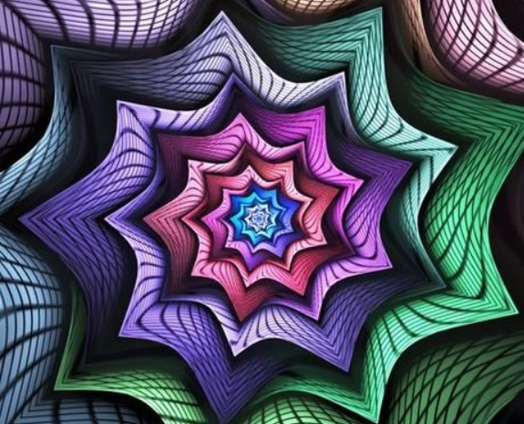
AI Art Value: My Opinion
AI can create as good things as human from the perspective of content
However, most AI artworks
Lack meaning (thoughts, emotions etc.) before creation
Possible Exceptions:
The first AI Artwork sold in an auction
Awesome algorithm behind the AI
Seldom get positive comments if known to be AI-created after creation
Possible Exceptions:
We can still appreciate some AI arts with good content
I will prefer to use AI “Creativity” instead of “Art”
Notes:
In summary, with the framework I introduced before, I will share my overall opinion on ai art.
Lack emotion, so we may find it hard to understand, or empathy with the artwork.
Also, I think most ai artworks seldom xxx, which can further negatively impact our evaluation on them.
As a result, their value may not compete with human arts, and thus I will xxx
But do we have to hold a competition between ai and human artist?

Slide 15
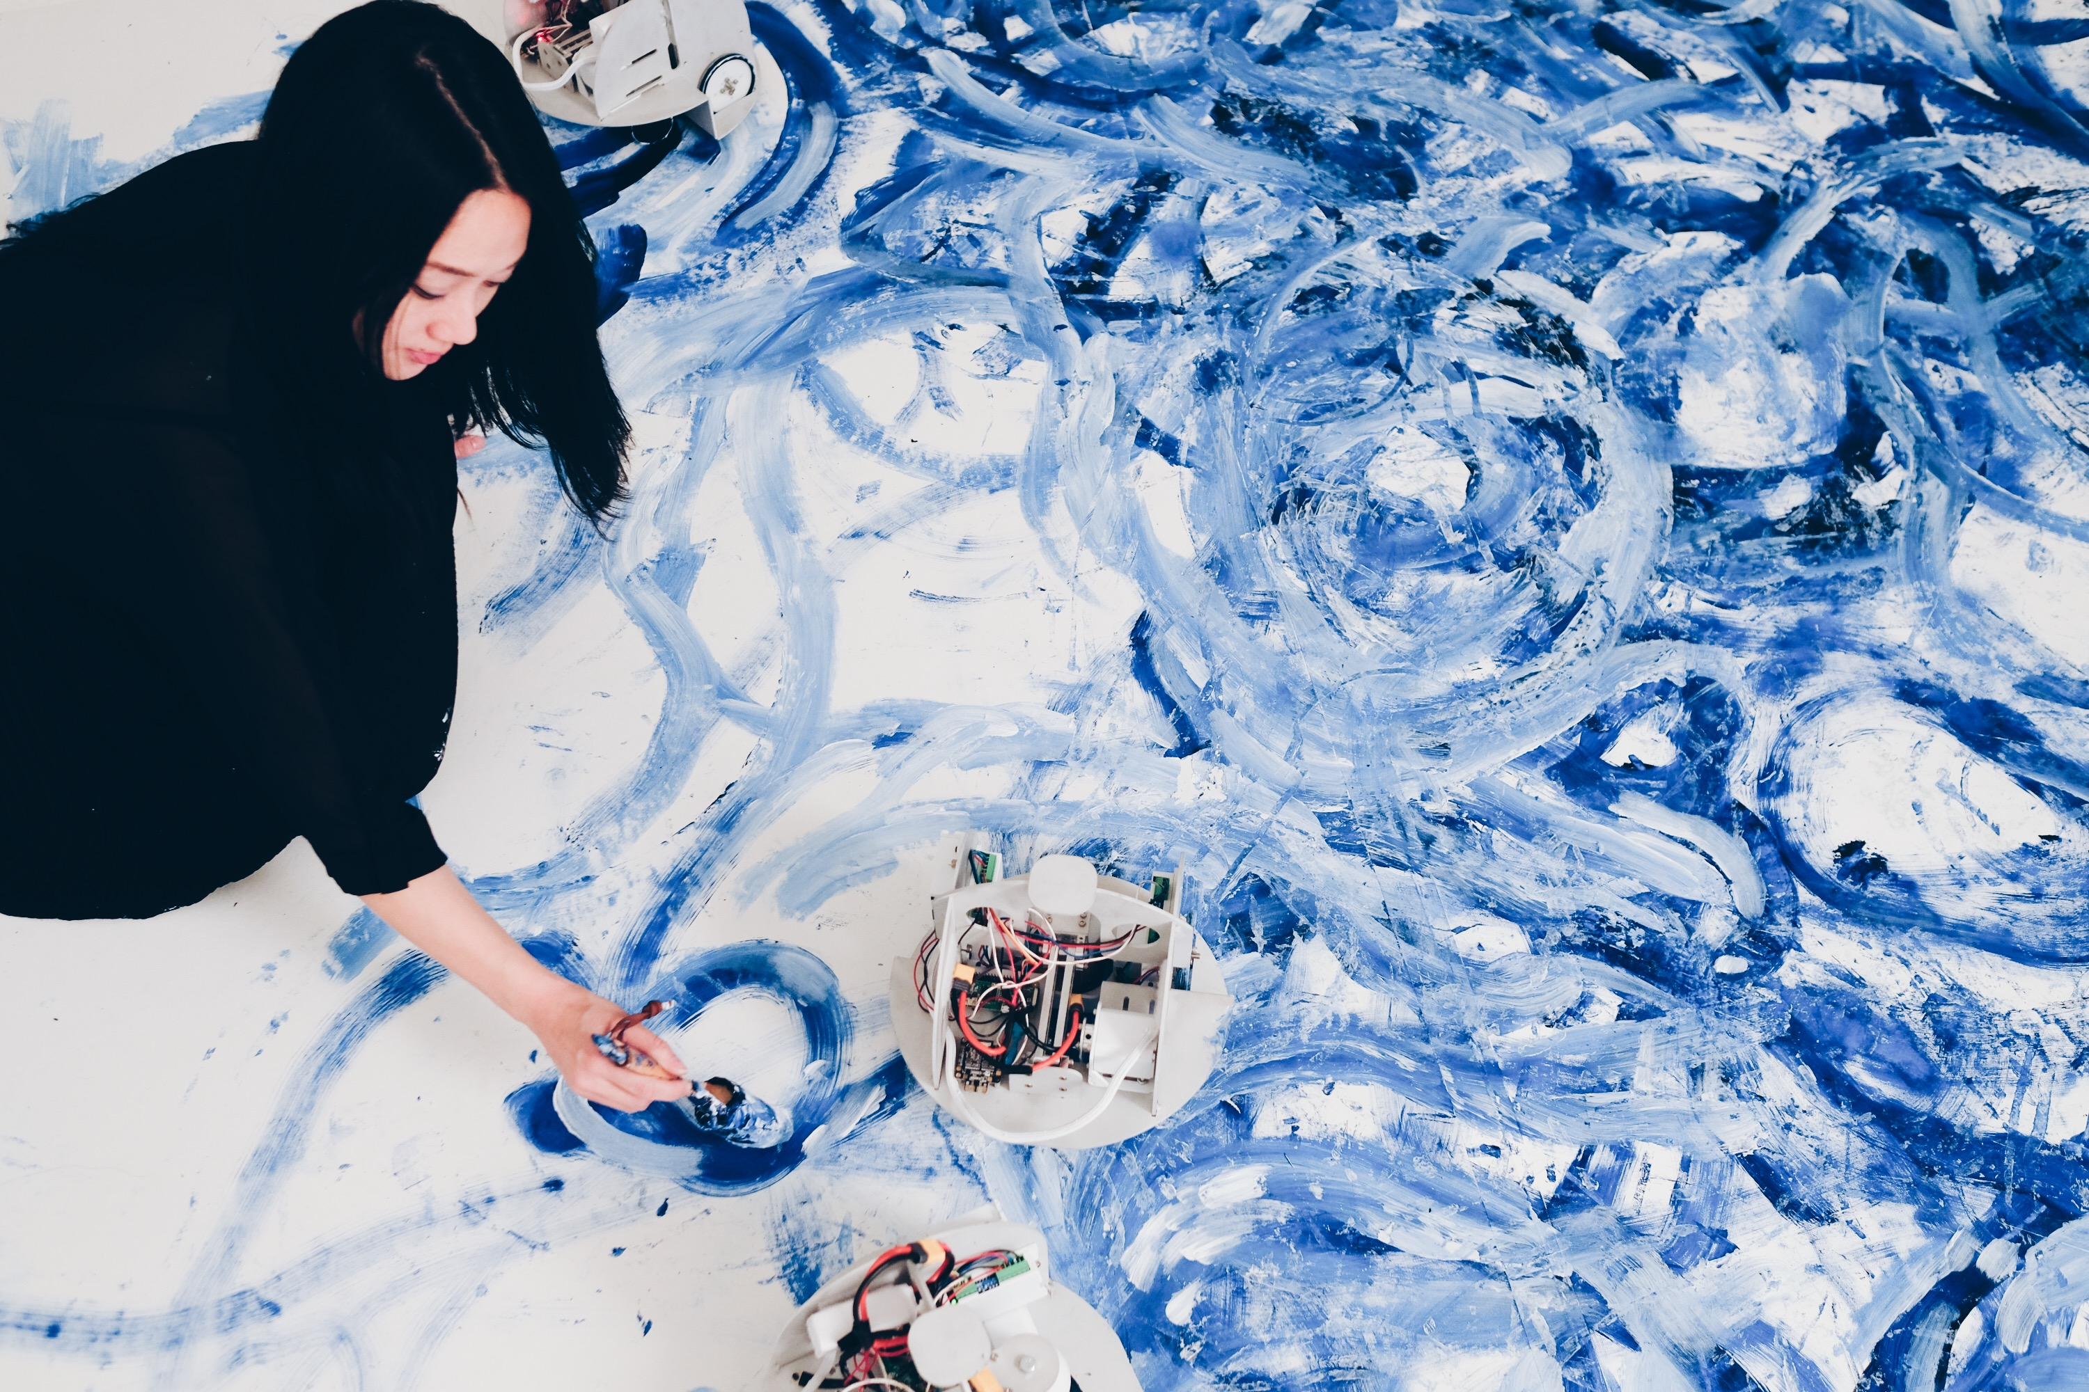
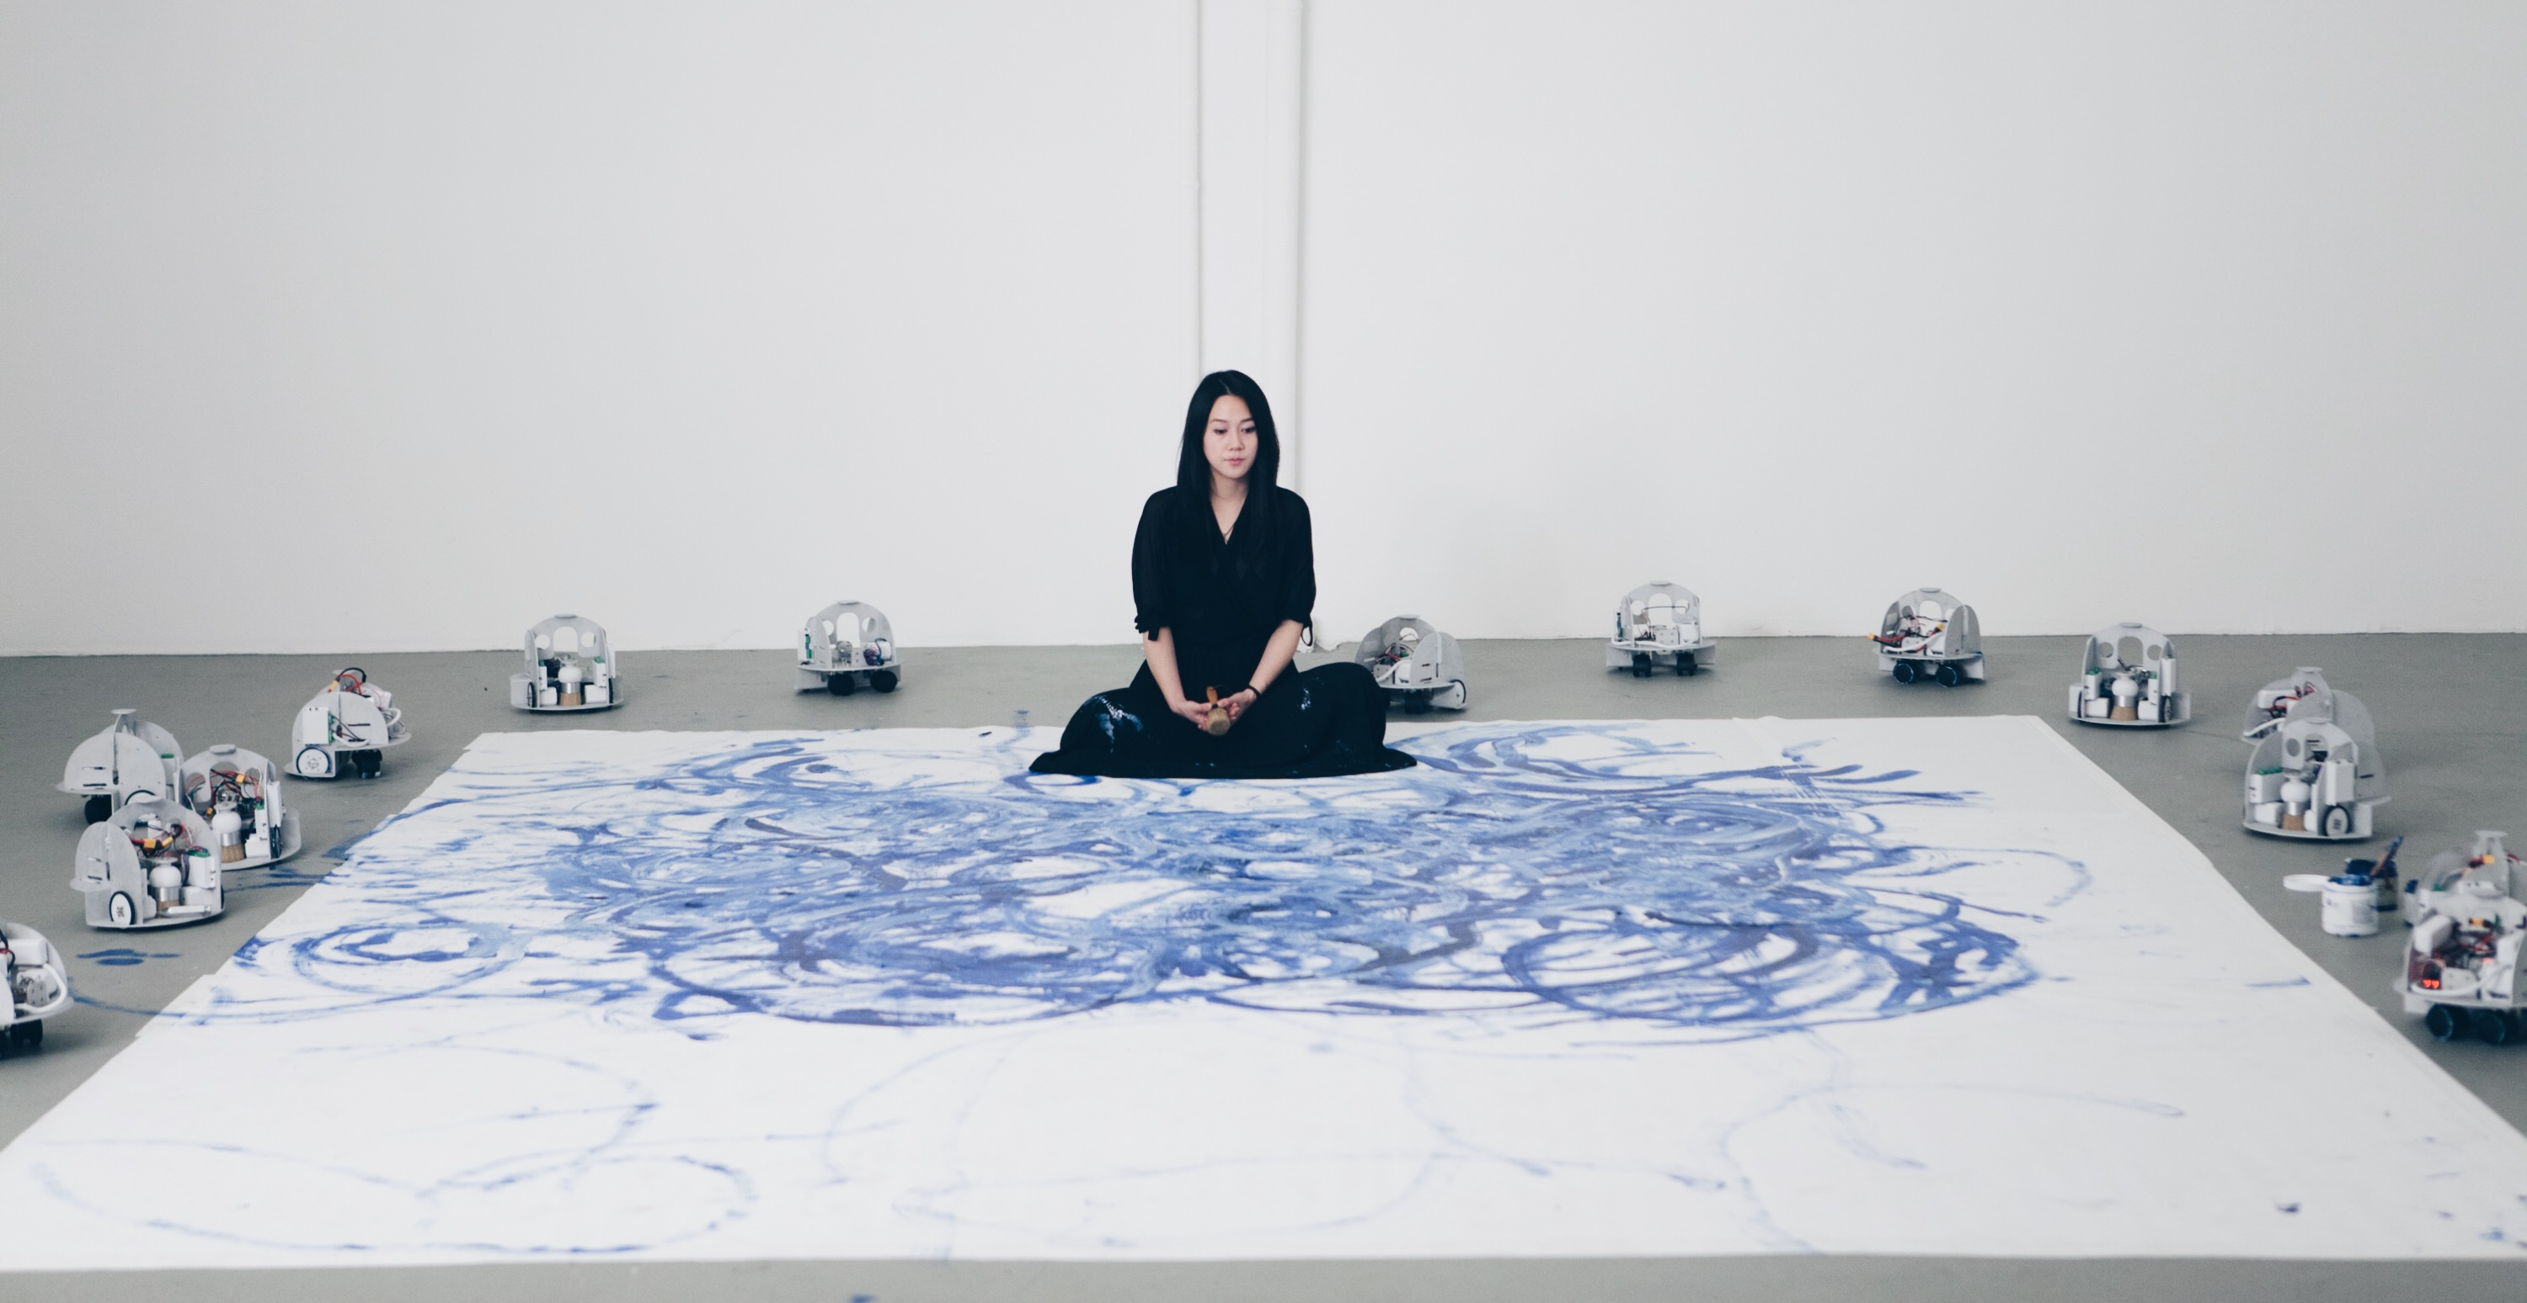
Human Creativity VS AI Creativity ?
Human-AI Co-Creation !
Notes:
Here I want to introduce a pioneer artist, Sougwen Chung. She doesn’t think we need to compete human creativity and ai creativity. Instead, we and AI can collaborate with each other.
She is a former research fellow at MIT’s Media Lab and a pioneer in the field of human-machine collaboration.
The drawing she’s setting on it the creation of both she and a robot swarm. (anime)
In my opinion, the robots created the bold curves highlighting the velocity and strength, while she is adding some spiritual strokes as a complementary.
So, her explorations told us that human-AI co-creation can be promising.
“AI+艺术”势不可挡，AI会是艺术的未来吗？ - 知乎 (zhihu.com)
Sougwen Chung (愫君) – works by sougwen

Slide 16
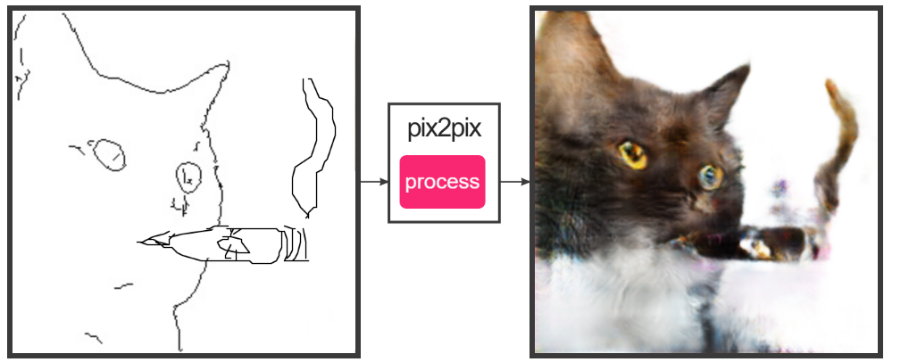
Human-AI Co-Creation
Combine the strength of AI and Human
Human: endow AI creations with meaning
AI: power human with technique
单身狗
清水饼干难下咽，
华歌月酒不能尝。
大龄蛋白宅男女，
学界萧条剩贱郎。
Notes:
A very good point of human-AI co-creation is that it can combine the strength of AI and Human.
First, human can endow AI creations with meaning. The GAN equation in the previous example is a typical example, created an interesting point to discuss.
Further, AI can power human with technique. It can lower the bar for low-skill users. As is shown in this pix2pix example, it can translate draft of a cat to a photo-like style, so that anyone capable of drawing a draft can enjoy this.
And let’s return to this 单身狗 example, we can see both directions here. Human suggested a interesting topic for AI. And AI help the user generate the poem. Otherwise, we know now very few of us can actually write a poem by ourselves.

Slide 17
Contents
Introduction
Creative Machine Generation
Model
Decoding Method
Human-AI Co-Creation
Conclusion
Notes:
Now, we will go to some technical stuff, discussing how is it possible for machine to be creative.

Slide 18
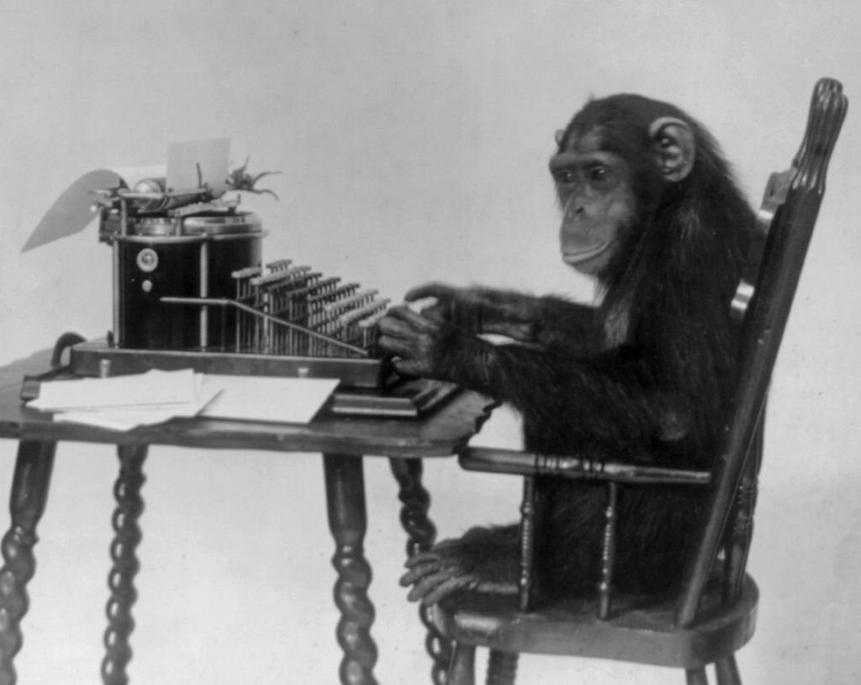
Infinite Monkey Theorem
A monkey hitting keys at random on a typewriter keyboard for an infinite amount of time will almost surely type any given text
such as the complete works of William Shakespeare.
Notes:
I will start with an important theorem.
So this theorem tells us that, in terms of producing the same content, even a monkey can create!

Slide 19
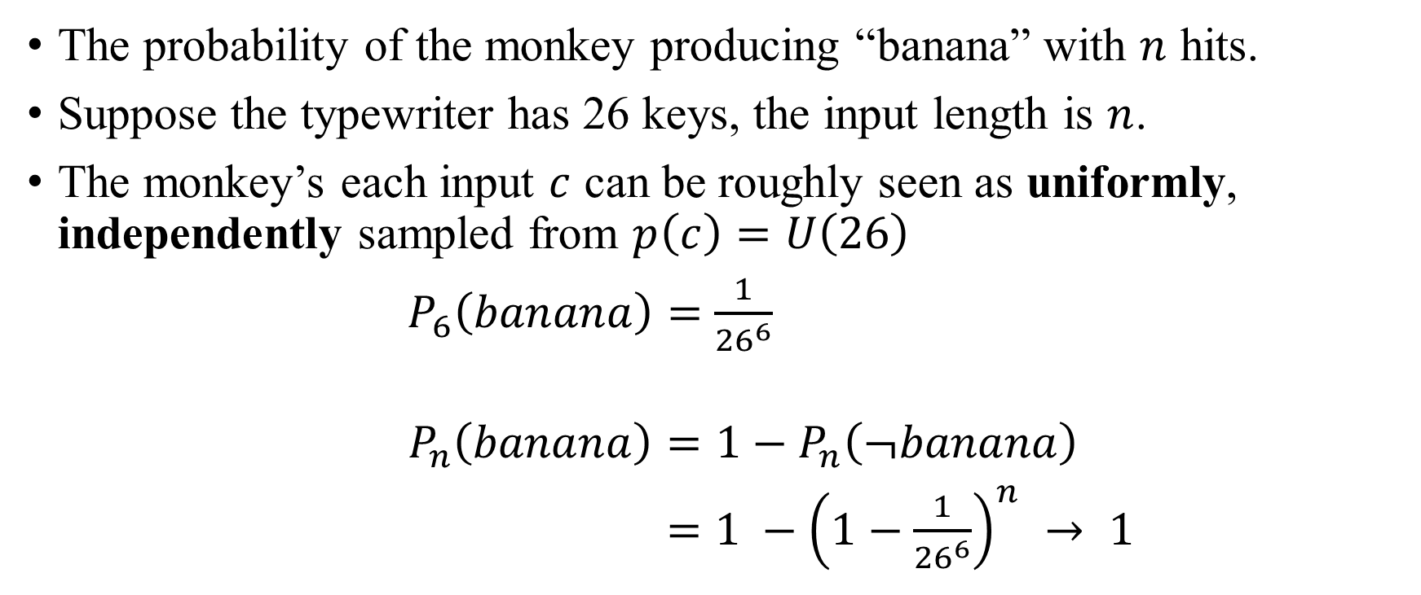
Infinite Monkey Theorem (Math)
The probability of the monkey producing “banana” with $n$ hits.
Suppose the typewriter has 26 keys, the input length is $n$.
The monkey’s each input $c$ can be roughly seen as uniformly, independently sampled from $p\left(c\right)=U\left(26\right)$
$P_{6}\left(banana\right)=$ $\frac{1}{{26}^{6}}$
$$P_{n}\left(banana\right)=1−P_{n}\left(¬banana\right)$$
$=1 −{\left(1−\frac{1}{{26}^{6}}\right)}^{n} → 1$
Notes:
Let’s discuss the mathematical details by an example.
XXX
Now we’ve proved the theorem. But how can we call such random thing as creativity? So I have a different idea.

Slide 20
Measure Creativity with Probability?
智者千虑必有一失，愚者千虑必有一得
P(得; 智者) = 0.999 > P(得; 愚者) = 0.001
Hypothesis: The more creative an agent (human/model/…), the more likely it can produce creative works.
We may measure the potential creativity of a model with its probability to produce creative works
A truly creative agent should be “smarter” than the monkey.
Notes:
We may consider creativity is one kind of intelligence.
And inspired by this old saying, we know we may measure intelligence with probability.
So, here comes my hypothesis: xxx
Then, we may xxx
And A truly xxx

Slide 21
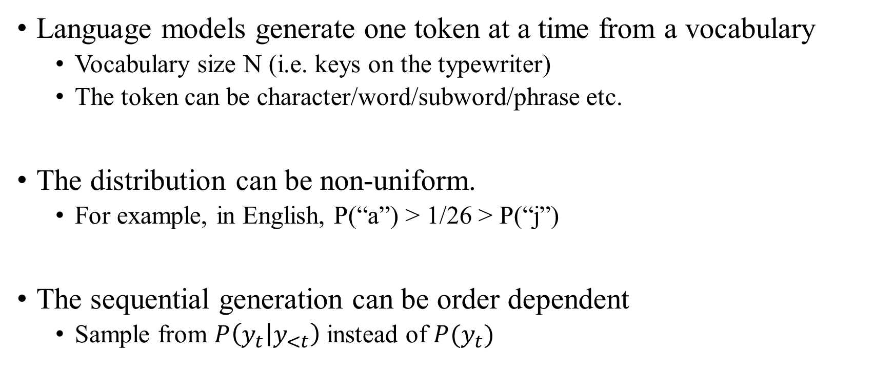
Language Model —— Smarter Monkey
Language models generate one token at a time from a vocabulary
Vocabulary size N (i.e. keys on the typewriter)
The token can be character/word/subword/phrase etc.
The distribution can be non-uniform.
For example, in English, P(“a”) > 1/26 > P(“j”)
The sequential generation can be order dependent
Sample from $P\left(y_{t} | y_{<t}\right)$ instead of $P(y_{t})$
Notes:
Now I will introduce our smarter monkey, that is the language model.

Slide 22
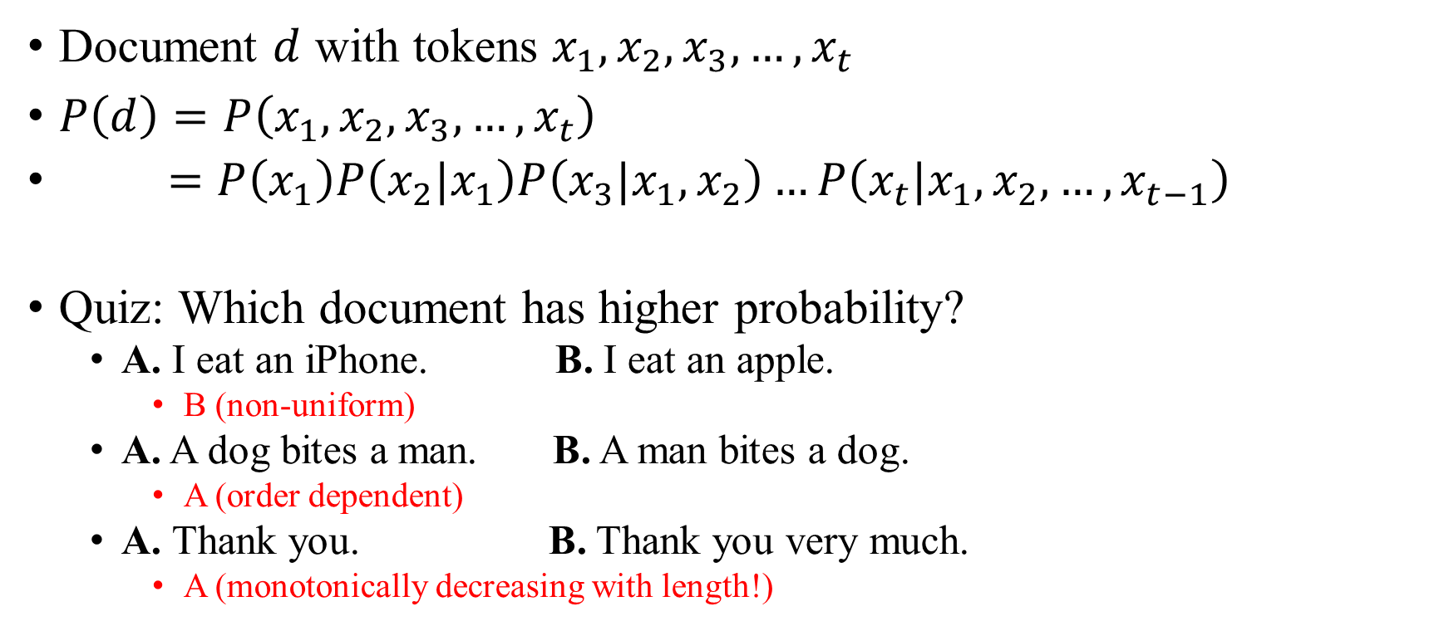
LM document probability
Document $d$ with tokens $x_{1},x_{2},x_{3}, …,x_{t}$
$P\left(d\right)=P\left(x_{1},x_{2},x_{3}, …,x_{t}\right)$
$=P\left(x_{1}\right)P\left(x_{2}|x_{1}\right)P\left(x_{3}|x_{1},x_{2}\right)…P\left(x_{t}|x_{1},x_{2}, …,x_{t−1}\right)$
Quiz: Which document has higher probability?
A. I eat an iPhone. B. I eat an apple.
B (non-uniform)
A. A dog bites a man. B. A man bites a dog.
A (order dependent)
A. Thank you. B. Thank you very much.
A (monotonically decreasing with length!)
Notes:
With a LM, we can now calculate the probability to generate a document like this.

Slide 23
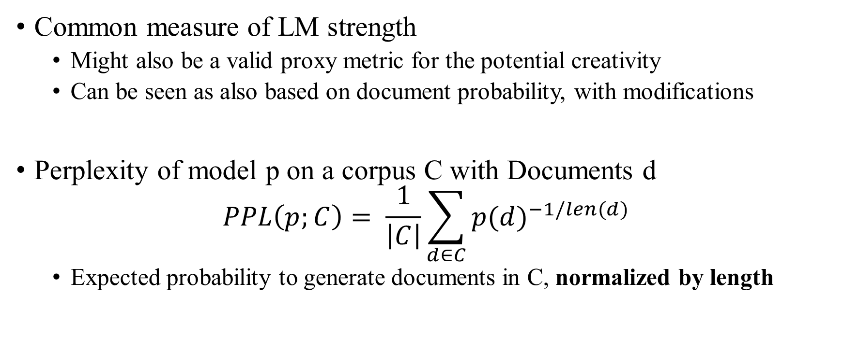
Perplexity
Common measure of LM strength
Might also be a valid proxy metric for the potential creativity
Can be seen as also based on document probability, with modifications
Perplexity of model p on a corpus C with Documents d
$$PPL\left(p;C\right)= \frac{1}{\left|C\right|}\sum_{d∈C}{{p(d)}^{−1/len(d)}}$$
Expected probability to generate documents in C, normalized by length
Notes:
The probability of one document cannot reflect the overall quality of a LM. So we usually use a more comprehensive metric, perplexity to measure the strength of a LM. And it might also be a valid xxx
It can be seen as xxx
The equation can be written like this, and you can see, this is the expected…
Why do we need to normalize by length here? This is to avoid the monotonically decreasing probability we’ve just seen in the quiz, so that each document will have similar contribution to the metric, regardless of length.

Slide 24
Perplexity of representative LMs
Benchmark: Penn Treebank
telephone speech, newswire, microphone speech, transcribed speech, etc.
Stronger model structure improves PPL
Pretrain helps PPL
Model | Perplexity
GRU | 92.48
LSTM | 78.93
Transformer-XL | 54.55
GPT-2 | 35.76
GPT-3 | 20.5
Notes:
Penn Treebank (Word Level) Benchmark (Language Modelling) | Papers With Code
How good are current LMs measured by PPL? Here I show you a benchmark.
From this we can see, how likely can LMs generate these content?
Compare xxx

Slide 25
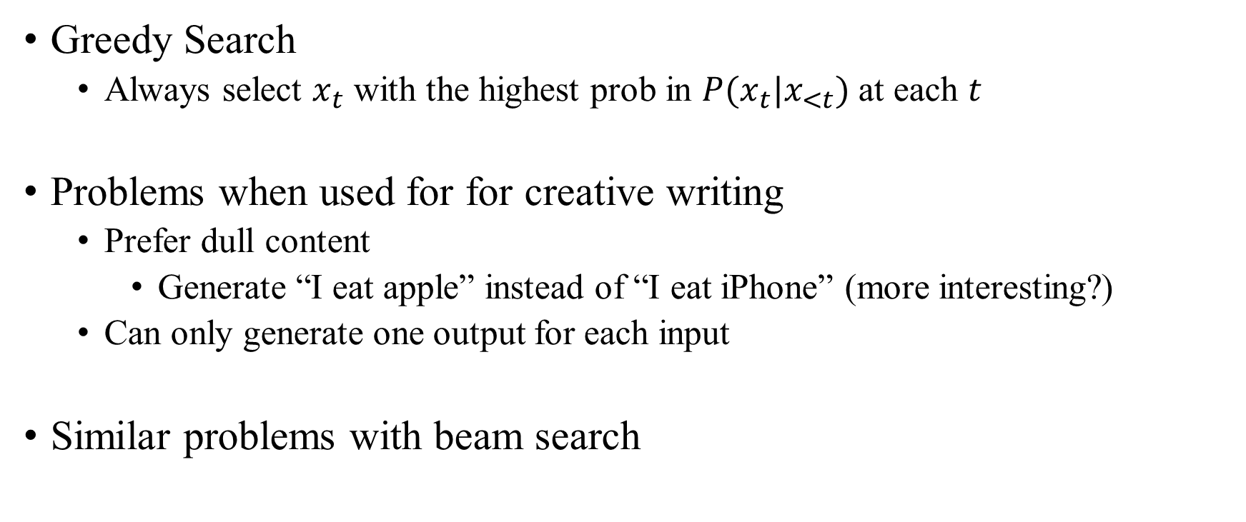
Decoding (Searching)
Greedy Search
Always select $x_{t}$ with the highest prob in $P(x_{t}|x_{<t})$ at each $t$
Problems when used for for creative writing
Prefer dull content
Generate “I eat apple” instead of “I eat iPhone” (more interesting?)
Can only generate one output for each input
Similar problems with beam search
Notes:
Now we’ve got the LM, but to actually generate content from it, we need to use some decoding method.
The first family of decoding method is searching, and the easiest one is greedy search. xxx

Slide 26
Decoding for creativity (sampling)
Random Sampling (The monkey’s keystroke)
We may get any output as the monkey, but very likely to get poor result
Improved Random Sampling
Only sample from more reasonable candidates
Top-K sampling
Top-p sampling (Nucleus sampling)
Notes:
Therefore, in creative applications, we will prefer sampling methods.
We may just use the naïve sampling method like the monkey’s keystroke, and we may xxx
In practice, we have better alternatives, (anime)
These improved random sampling methods only sample from more reasonable candidates to ensure the generation quality

Slide 27
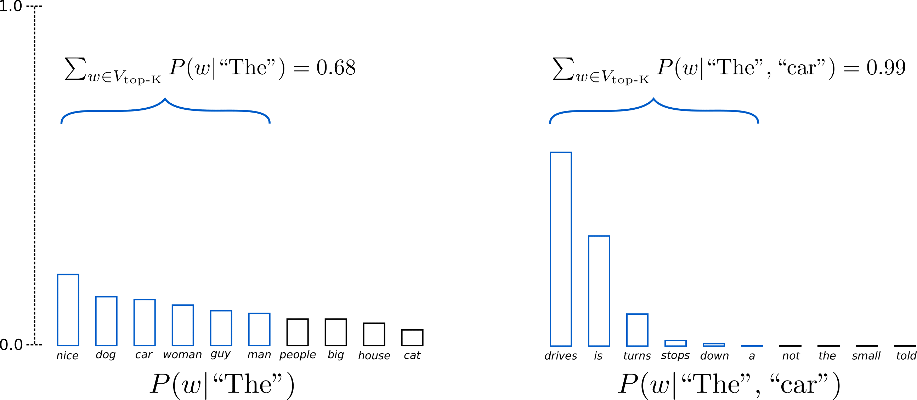
Top-K sampling
Limit our sampling pool to the most likely K words
Sometimes loses many reasonable continuations (lose 32%, left case)
Notes:
The first one is Top-K sampling.
The basic idea is to
https://huggingface.co/blog/how-to-generate

Slide 28
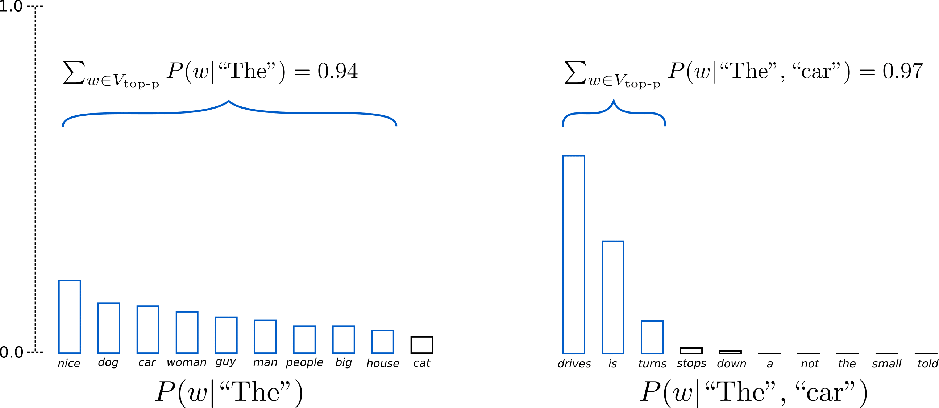
Top-p sampling (Nucleus sampling)
Chooses from the smallest possible set of words whose cumulative probability exceeds the probability p.
Flexible number of candidates per step, covers most possibilities

Slide 29
Quiz: Sampling methods
P(w| “I eat”) =
Q1: Which words can be sampled under top-K(K=3) sampling?
Apple, egg, banana
Q2: The minimum p to set if we want “iPhone” to be sampled under Top-p sampling?
0.95
Vocabulary | apple | banana | cherry | egg | iPhone | (others)
Probability | 0.4 | 0.15 | 0.1 | 0.3 | 0.04 | 0.01
Notes:
Now we are giving the language model “I eat” as context, and we got the distribution for next token in this table

Slide 30
Contents
Introduction
Creative Machine Generation
Model
Decoding Method
Human-AI Co-Creation
Conclusion
Notes:
Next part, I will introduce some possibilities of Human-AI Co-Creation in NLP.

Slide 31
Human in the loop
AI-only generation: Sampling from P(document)
Direct human intervention: Modification on generated results
Extend the generation, Fix problems, etc.
Conditioned generation: P(document | human intent)
Easier to express intent than direct writing
Guide the machine generation with minimum skill requirement for human
Notes:
AI-only generation takes the form of simply sampling from P(document)
And how can we let human participate in the loop?
The next one is conditioned generation, where we inject human intent as the condition of the generation model. (anime)
Since expressing intent is easier than direct writing. This method can xxx
We will focus on conditioned generation later.

Slide 32
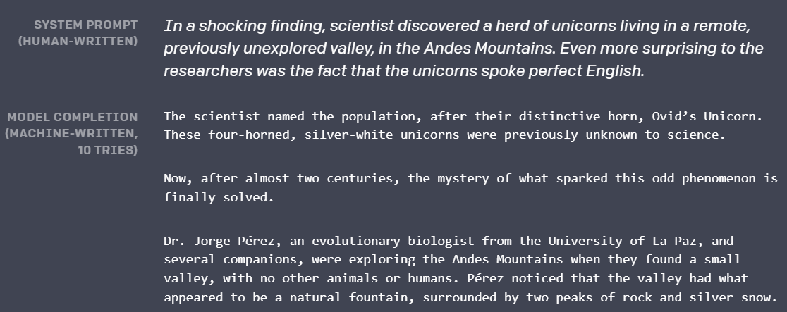
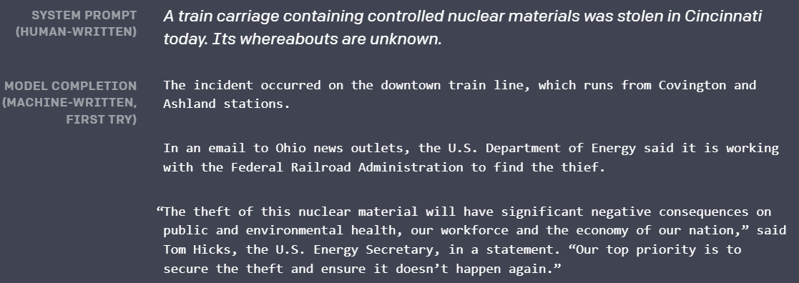
Condition: Prompt
OpenAI: Too dangerous to release!😱
Notes:
First kind of condition is prompt.
This is the example of GPT-2 I put at the very beginning. The first paragraph is the human written prompt, and GPT-2 gives a reasonable continuation.
Actually, I think the most imaginative part is the human written part. Without the starting, it may not generate such an interesting story. (anime)
And OpenAI uses this example to boast the strength of their model, and even claim that GPT-2 is too dangerous to release. I think it’s a really clever marketing strategy.
Anyway, if we provide it with a different prompt, we will get another story that roughly follows the previous context.
This shows that prompt can be a simple and effective condition.

Slide 33
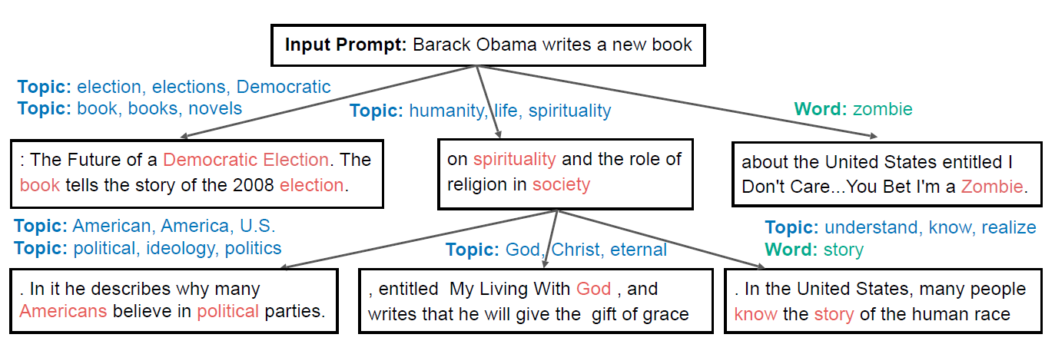
Condition: Topic
Predict possible future topic given input
User chooses topics as additional condition for future generation
Chang, Haw-Shiuan, et al. "Changing the Mind of Transformers for Topically-Controllable Language Generation.“ EACL 2021
Notes:
Here, topic is defined as a set of words that the LM are more likely to generate in the future.
This work allows the model to predict possible future topic given input.
And User can choose one or more topics as an additional condition for future generation.

Slide 34
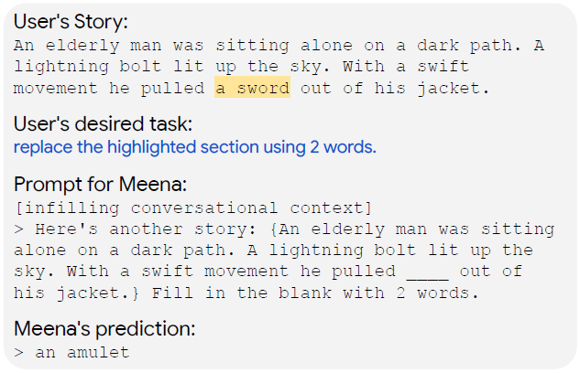
Condition: Conversation
Using pretrained Dialog Model, Meena
Formulate task instruction as dialog-style prompt
Conversations are inherently interactive, so may be better suited for interactive writing than general LMs like GPT-2
Coenen, Andy, et al. "Wordcraft: a Human-AI Collaborative Editor for Story Writing.“ EACL Workshop 2021
Notes:
Another interesting idea is that we can formulate our intent in the form of conversation, so that we can leverage the strength of pretrained dialog model. Here they used Meena.
As we can see in this example. (anime)
Why do they use conversation? Because they believe that Conversations are inherently interactive, so may be better suited for interactive writing than general LMs like GPT-2 .
And I think the form of conversation can also allow more flexible and user-friendly interactions with the model.

Slide 35
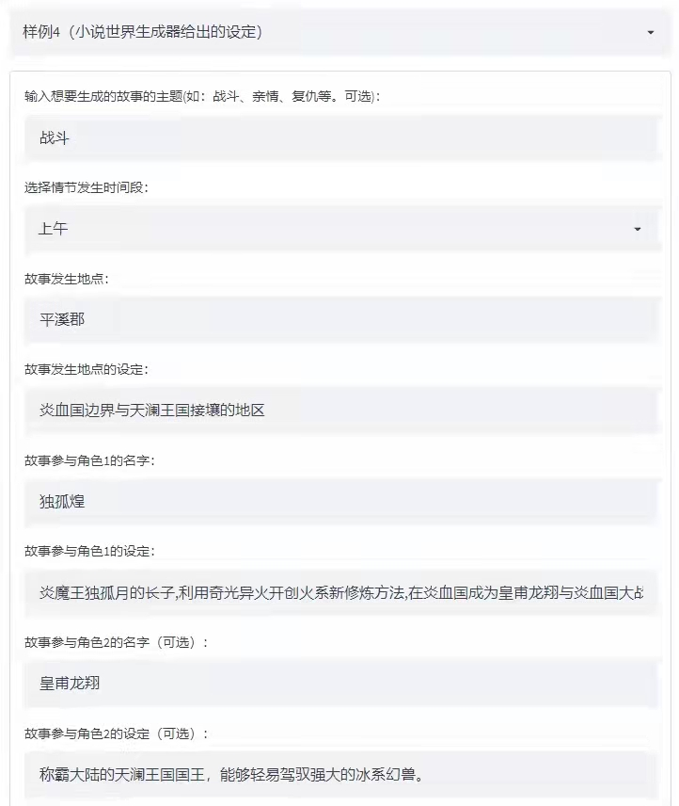
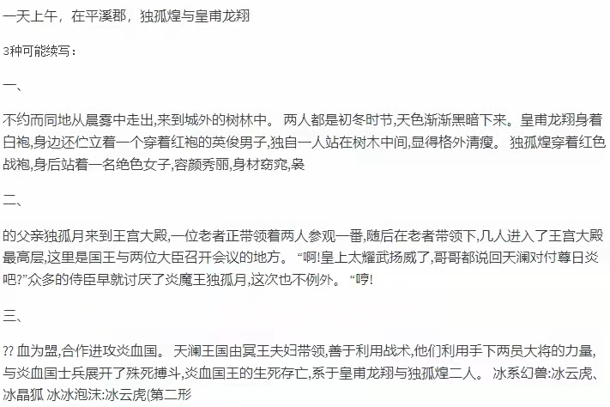
Condition: Theme & Description
"NoWoC: A Human-AI Collaborative Novel World Creator.“ Submitted to IJCAI2022 Art & Creativity Track
Notes:
This is my final example, and some of you might be familiar with it, because this is my work and I’ve let some of you tested it.
Here, the condition I support is the theme of the story and the descriptions of the involved entities.
As you can see, I expect to generate a fighting story, with xxx and xxx as the main characters. And usually the generation is coherent with the setting I specified.
I have integrated this functionality into a system called NoWoC with more other interesting features, and I’ve submitted it to IJCAI.
Wish me good luck.

Slide 36
Contents
Introduction
Creative Machine Generation
Model
Decoding Method
Human-AI Co-Creation
Conclusion

Slide 37
Conclusion
Recent AI has shown impressive potential for creative applications
Achieved mainly by smart sampling
However, the value of AI art/creativity alone can be limited
Can produce good content, but may lack “meaning” behind the creation
Lacking in human perspectives for audience to appreciate after creation
Human-AI Co-Creation is a promising direction
Injecting human thoughts in generation condition to guide AI
Notes:
xxx
Many of the opinions are my personal perspective on AI creativity, and might not be universally acknowledged, so I would also appreciate it if you can leave some comments, Thanks!

Slide 38
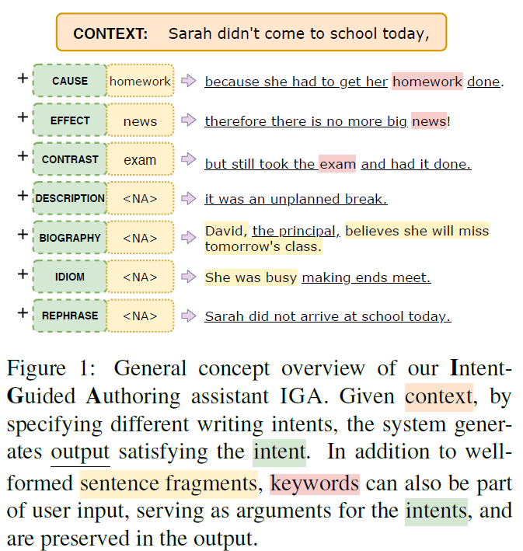
Condition: Intent
Pre-defined intent types
Supervised learning from several existing datasets matching the intent
Specify keywords to appear
Using Infilling LM
Preserve keyword in the middle
In: <mask> exam <mask>
Out: but still took the exam and had it done.
Sun, Simeng, et al. "IGA: An Intent-Guided Authoring Assistant.” EMNLP 2021

Slide 39
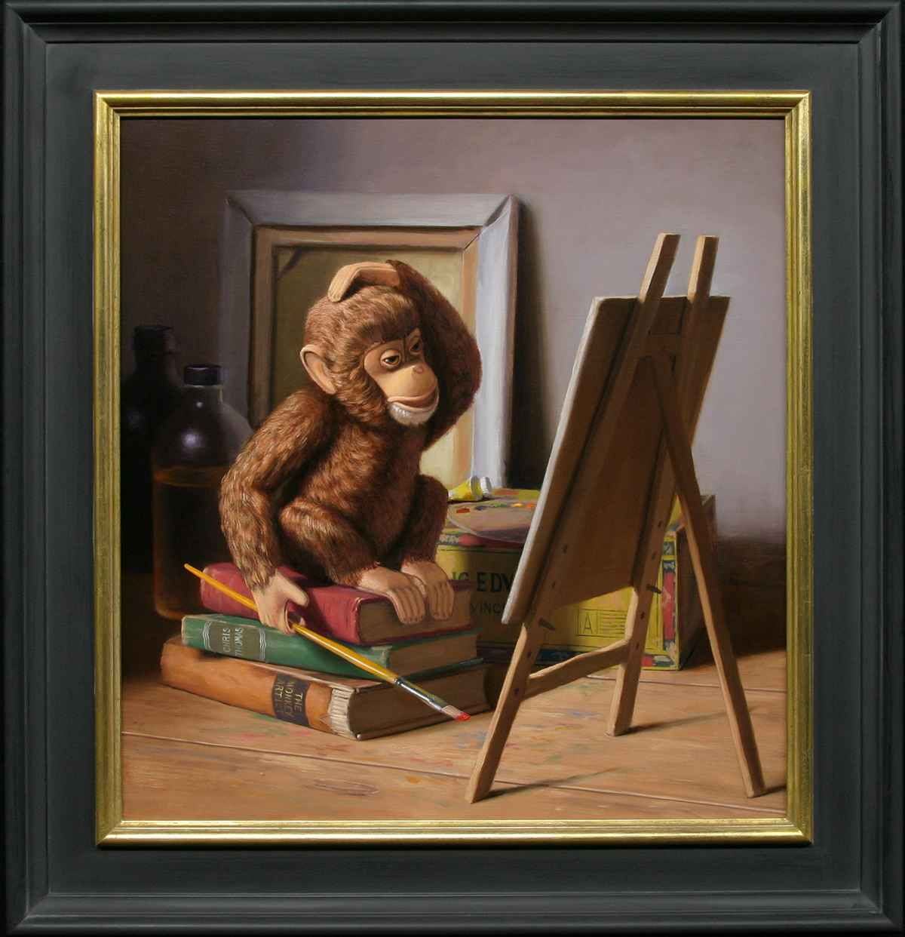
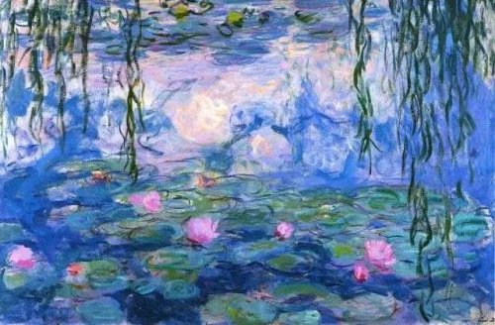
Conclusion
Art reviews of Monet
Monkey Artist
AI Creativity
Notes:
After all, I’m not giving an art review of monet, or talking about an monkey artist.
But I hope I can use these examples to illustrate my views on AI creativity.

